Slide 1

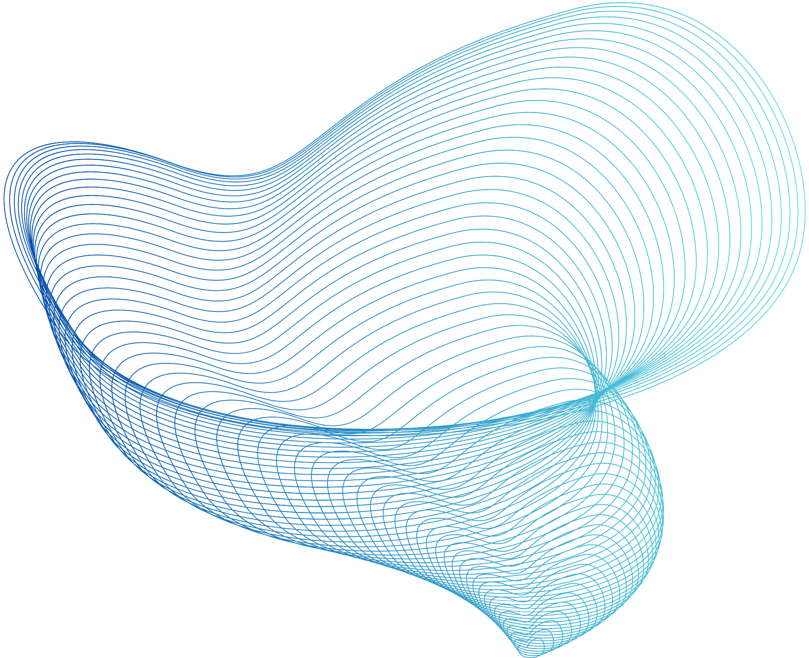

Mouri Tech Global Enterprise Solutions Pvt. Ltd.
INTERNSHIP
LEARNINGS
Murari
srisaim.in@mouritech.org

Slide 2
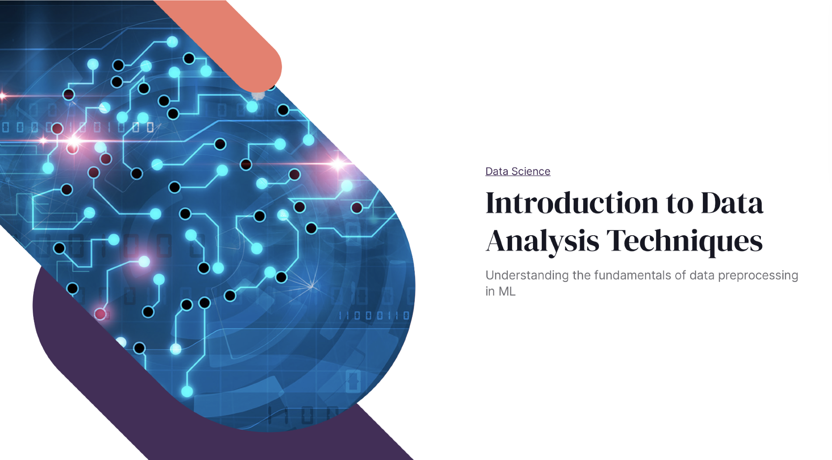

Slide 3


Slide 4
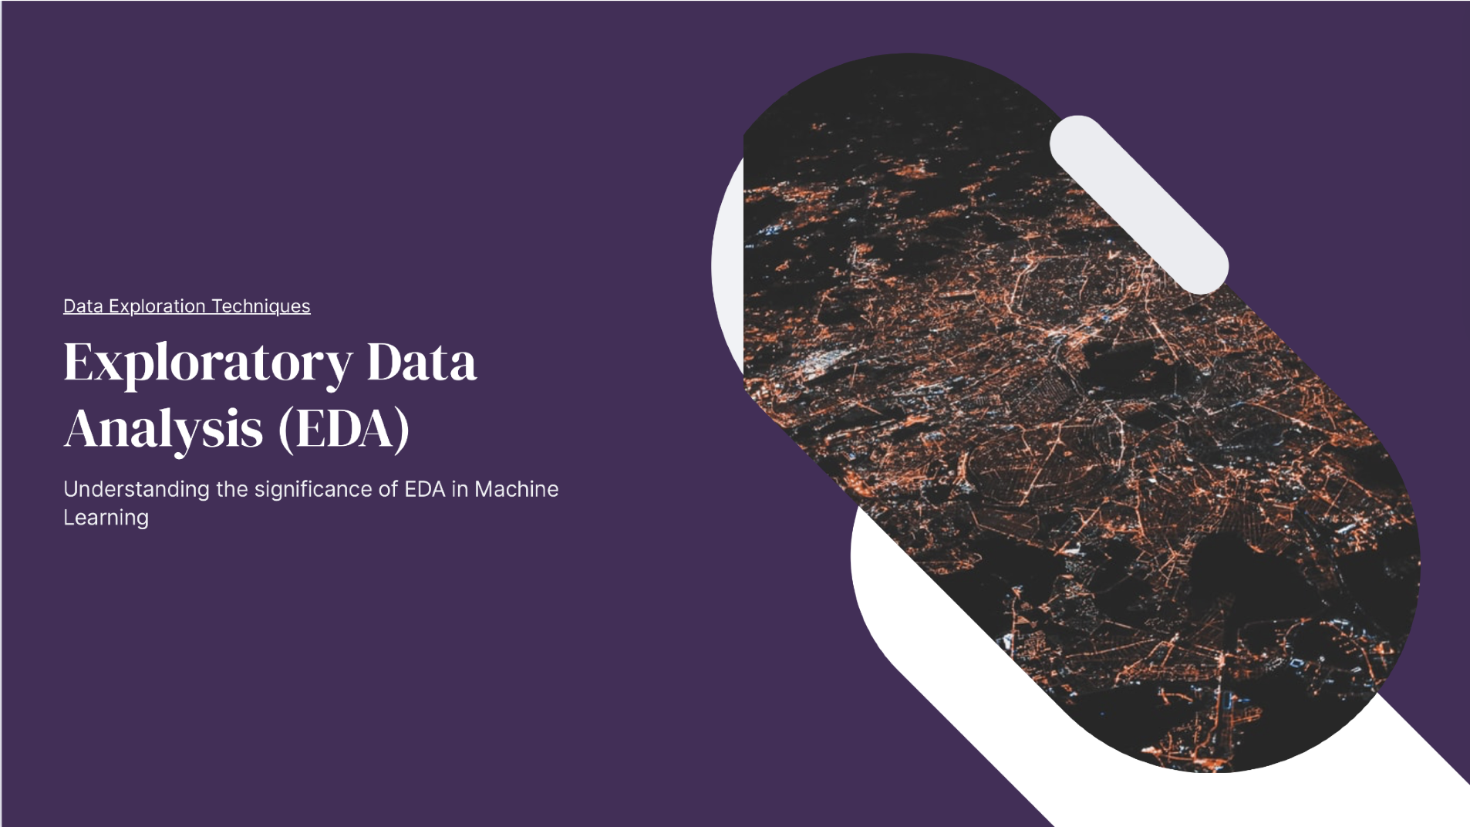

Slide 5
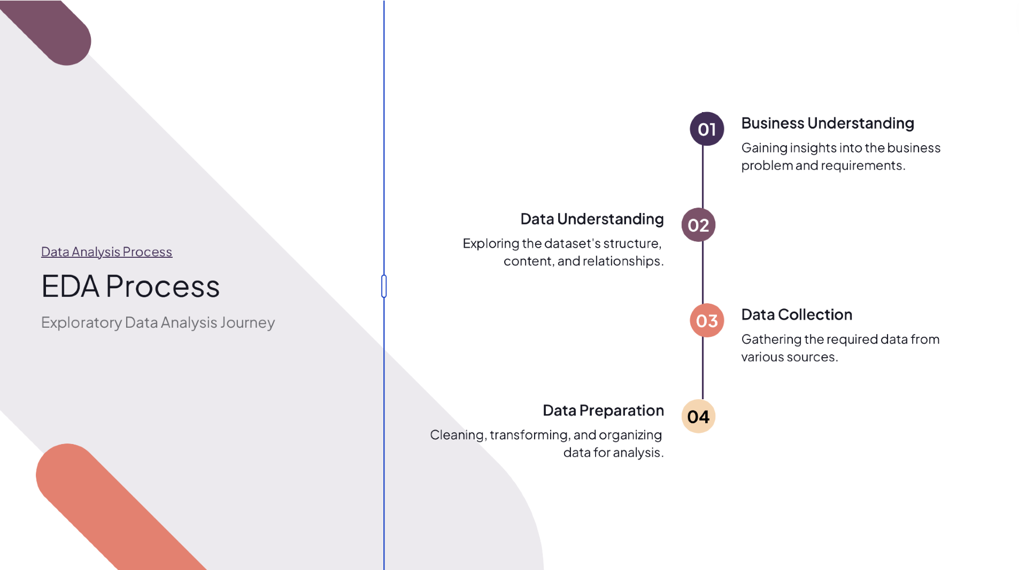

Slide 6
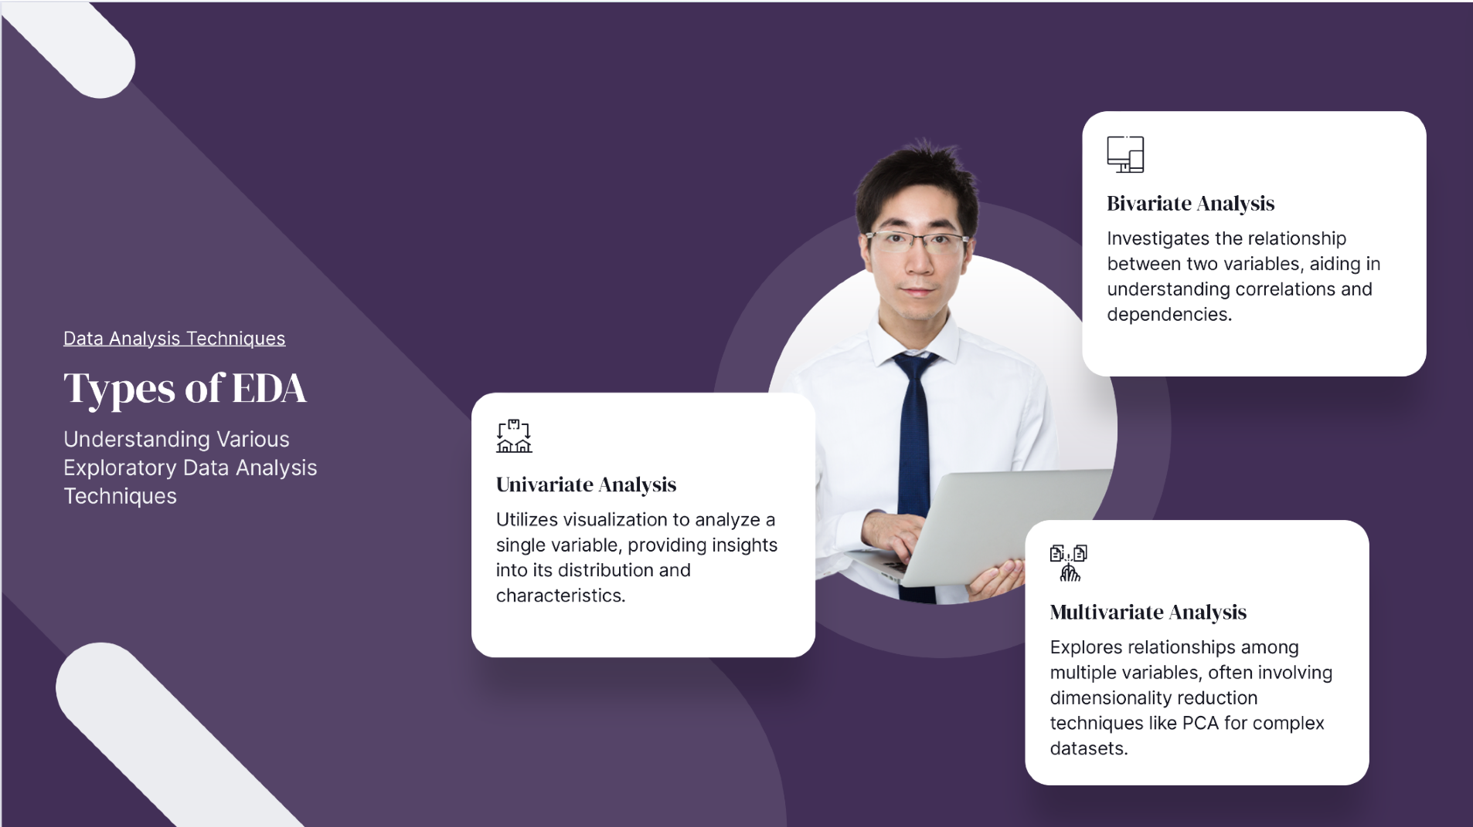

Slide 7
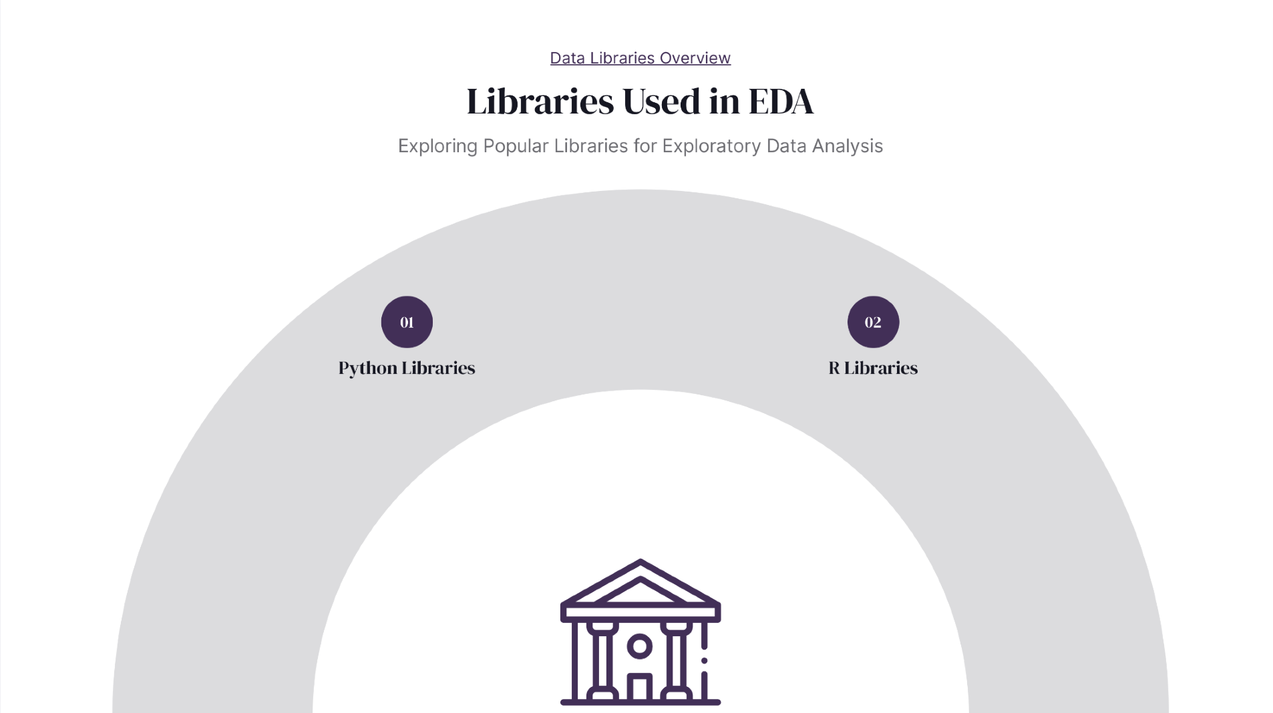

Slide 8
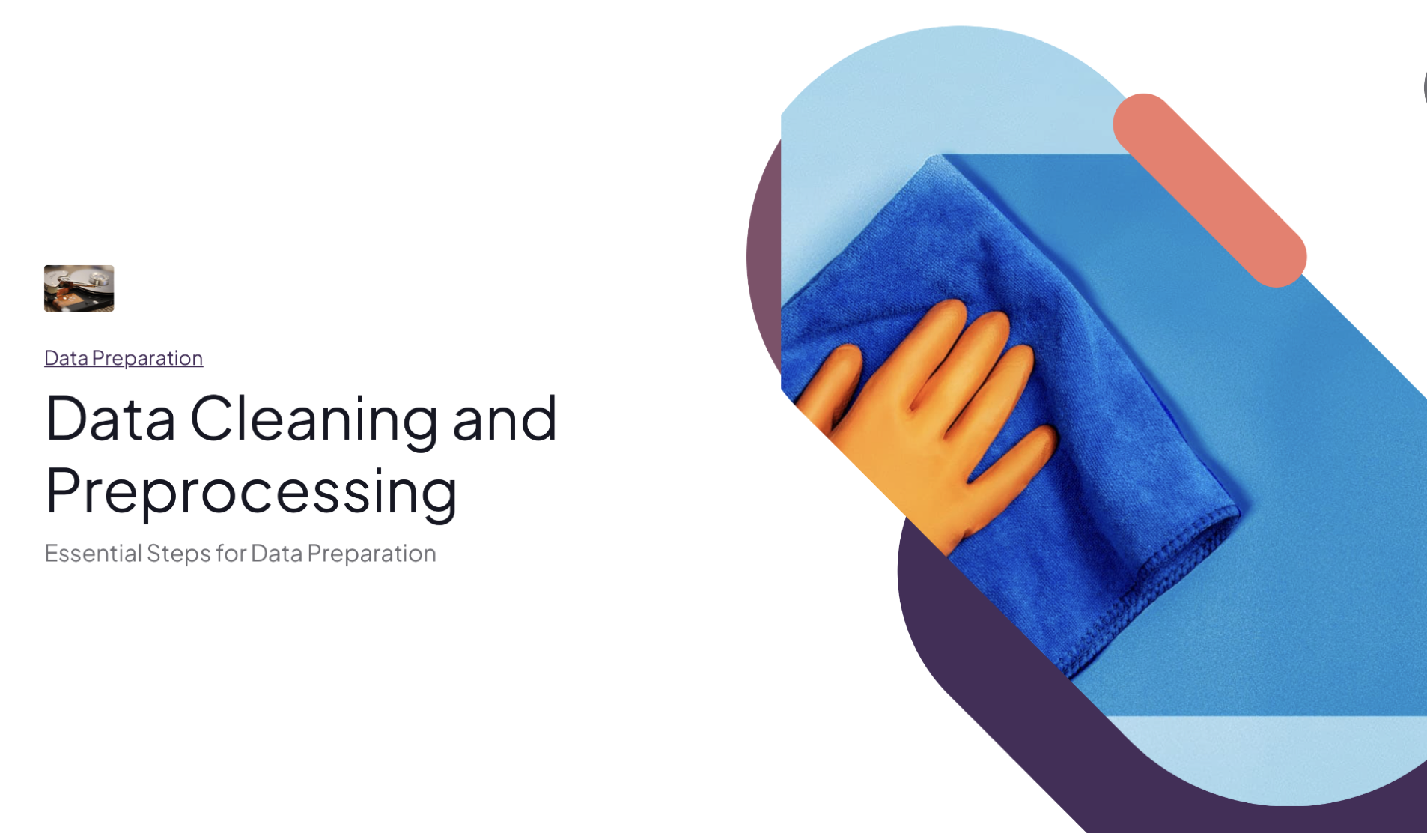

Slide 9


Slide 10
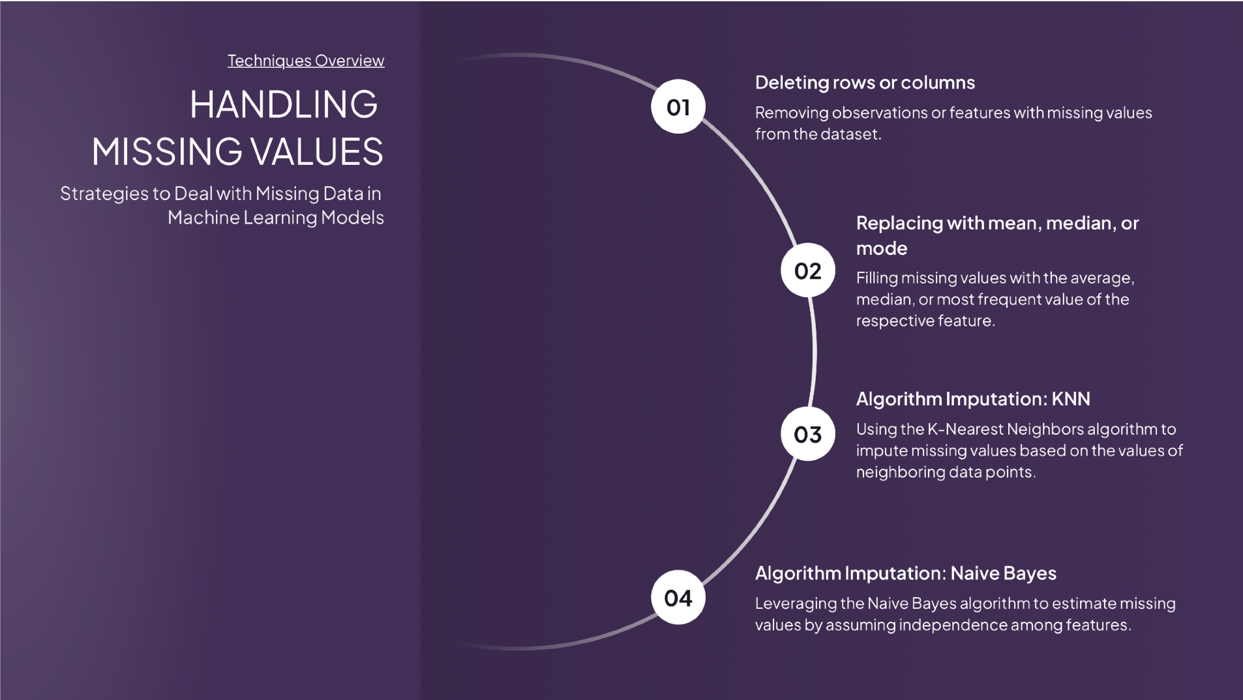

Slide 11
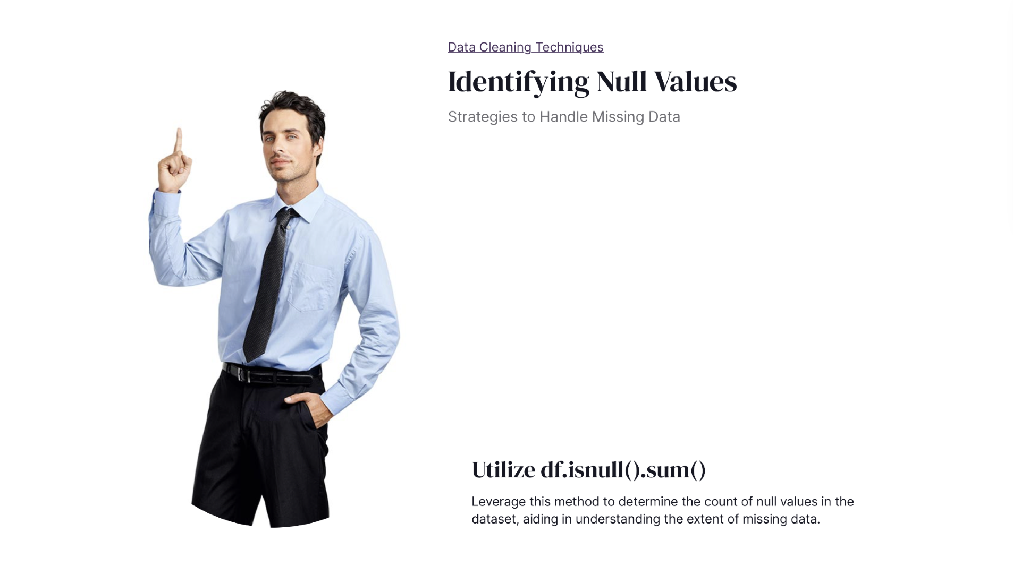

Slide 12
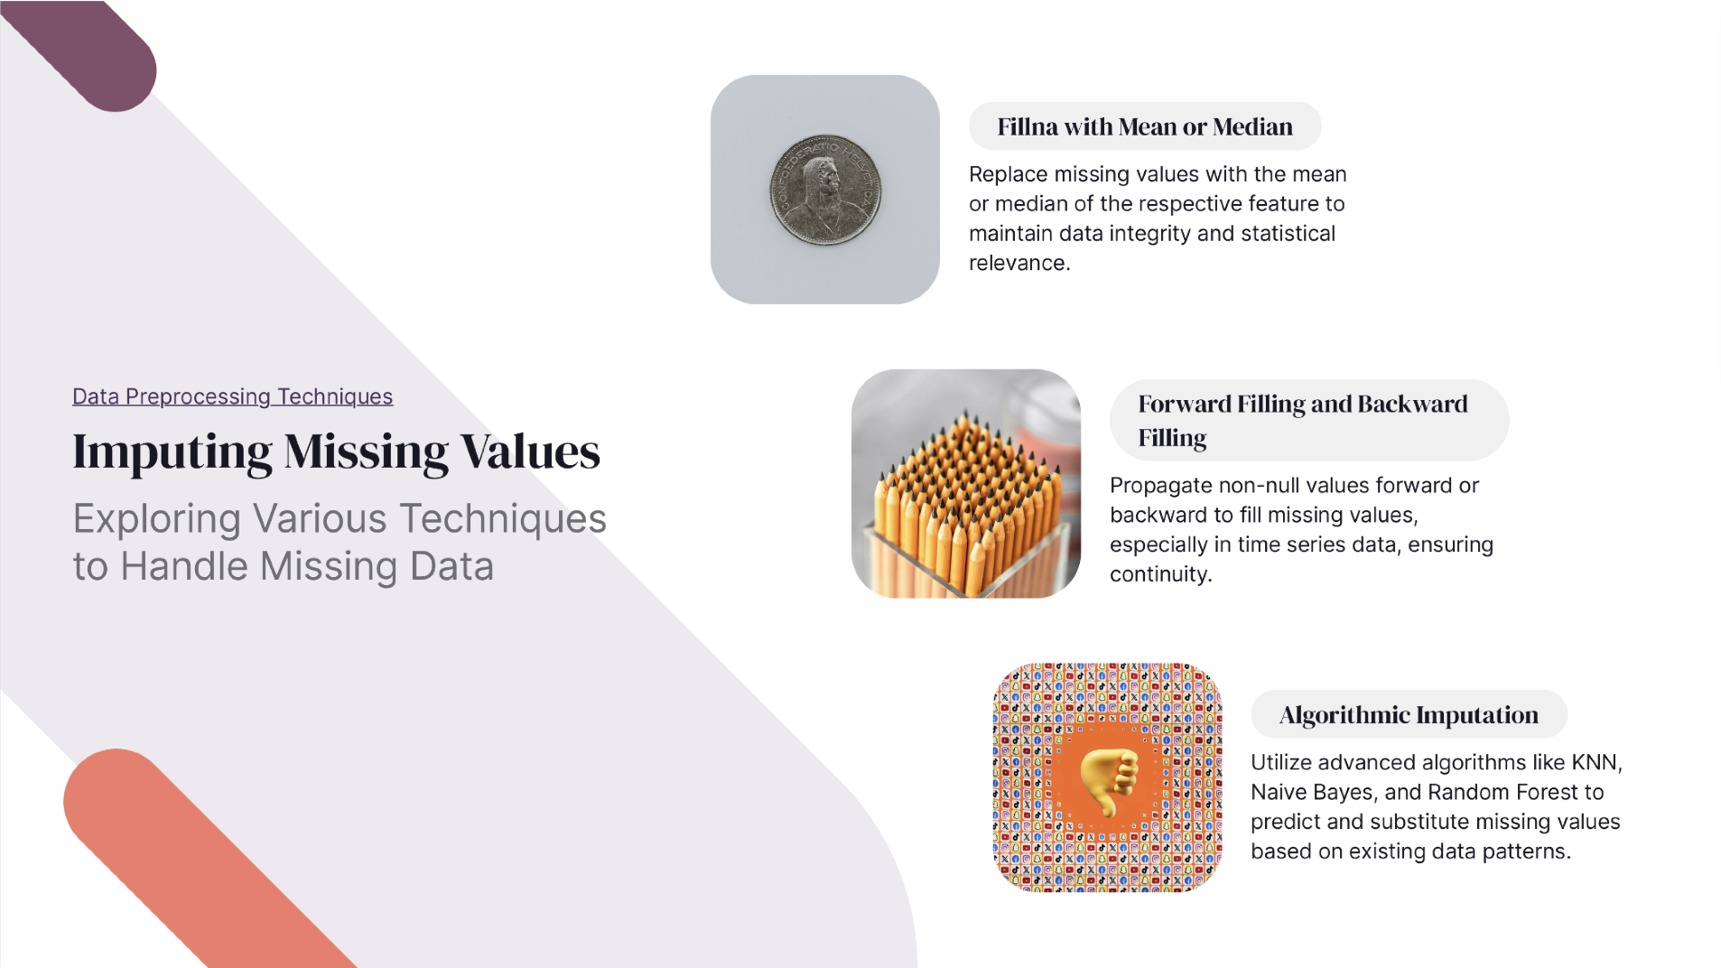

Slide 13


Slide 14


Slide 15
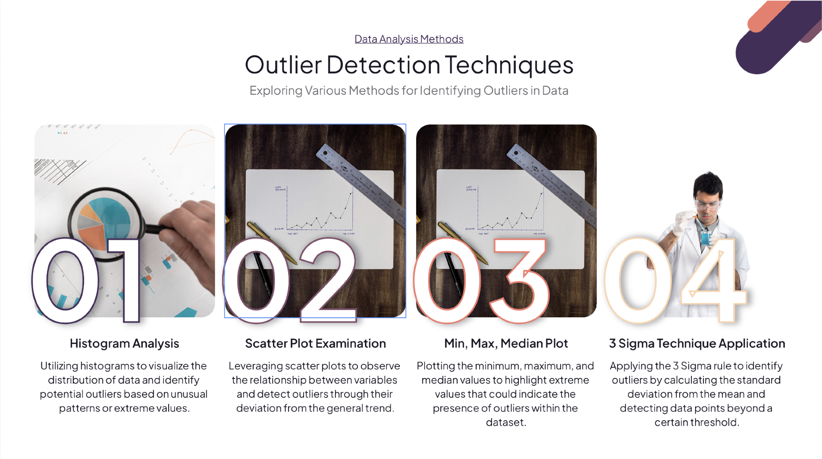

Slide 16


Slide 17
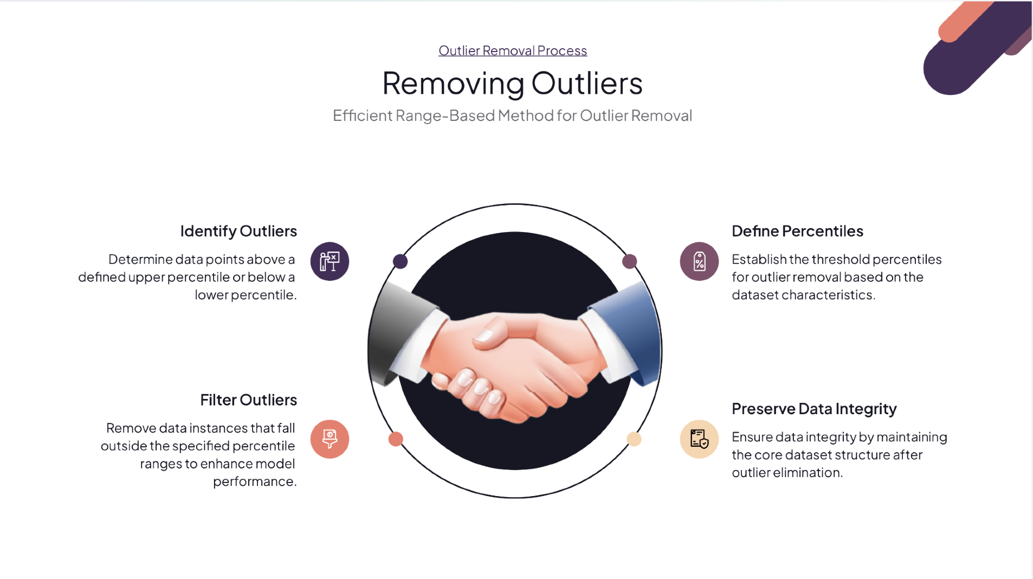

Slide 18
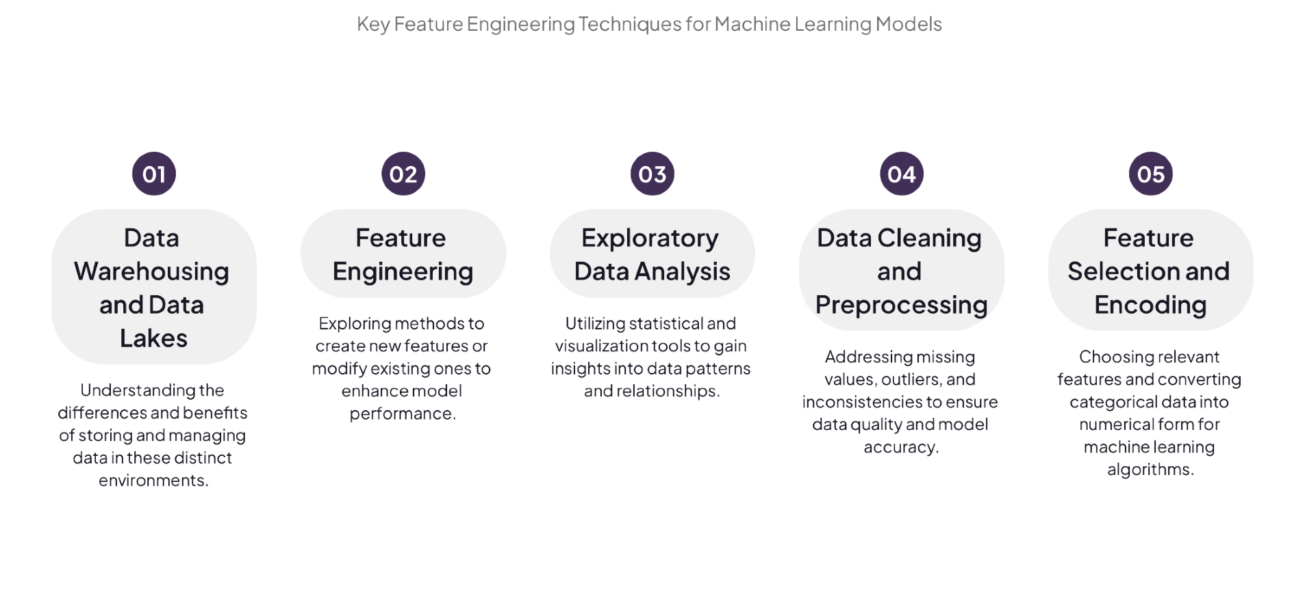

Slide 19
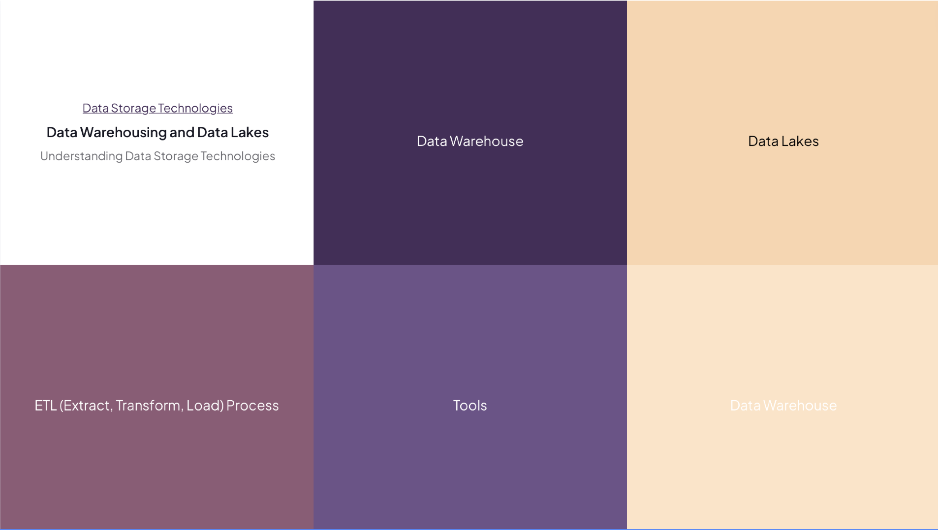

Slide 20


Slide 21
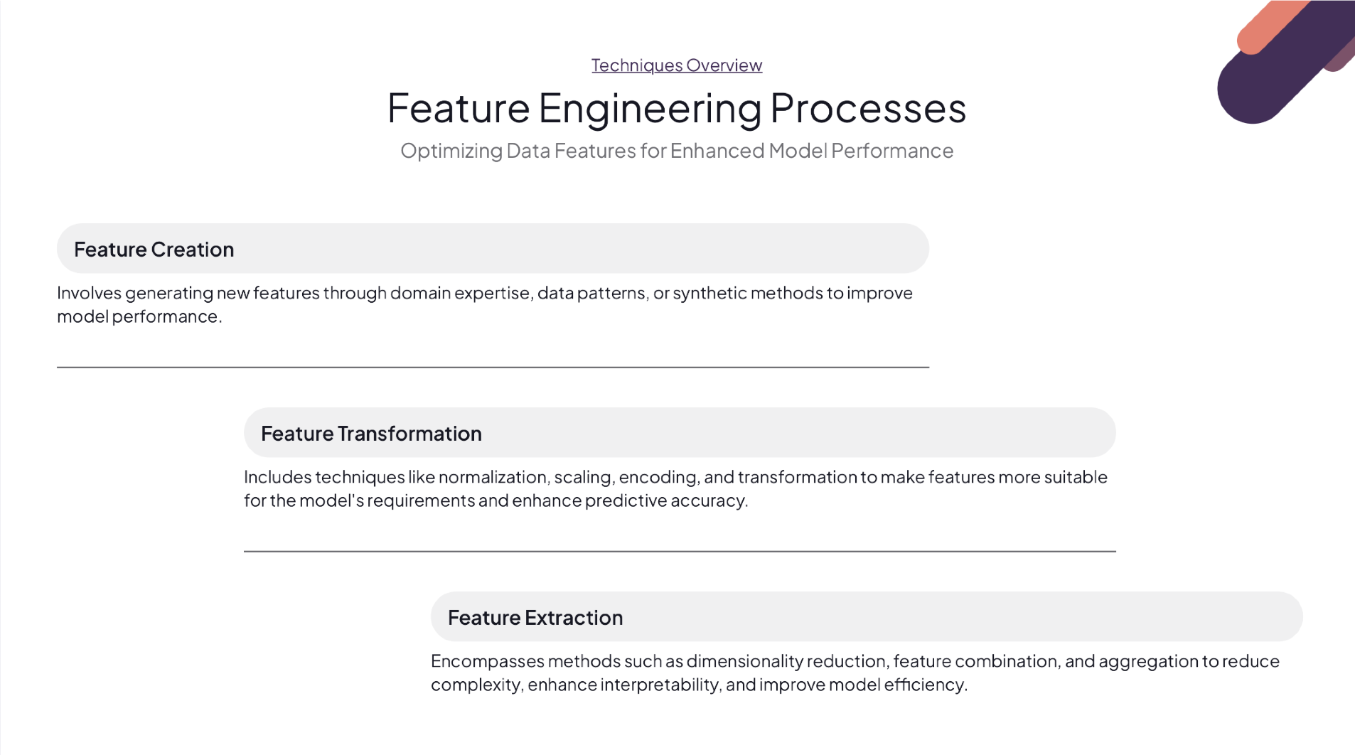

Slide 22
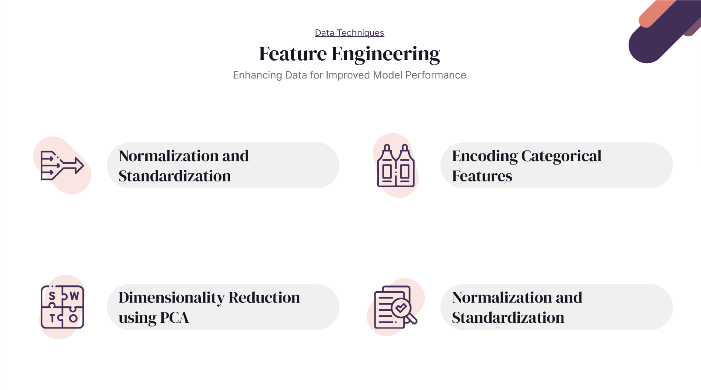

Slide 23
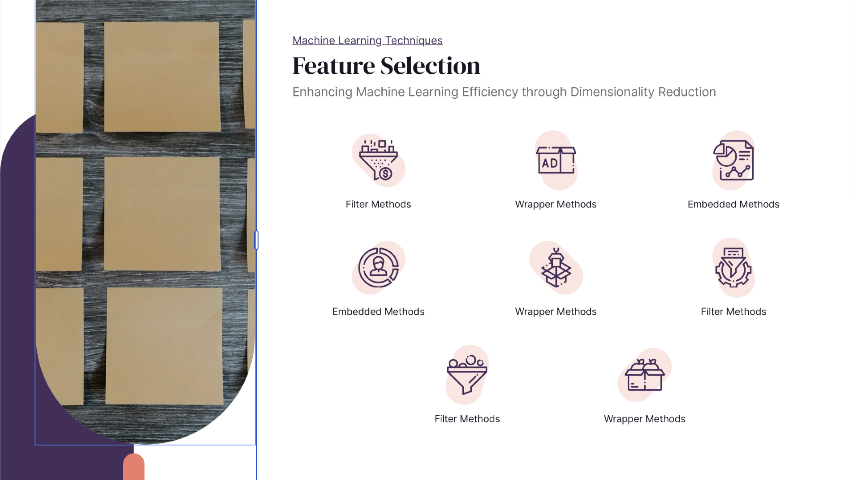

Slide 24
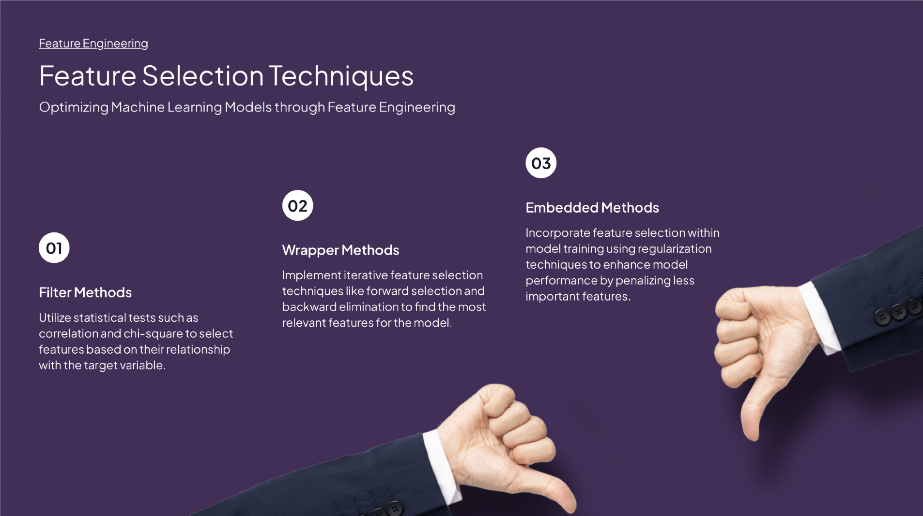

Slide 25
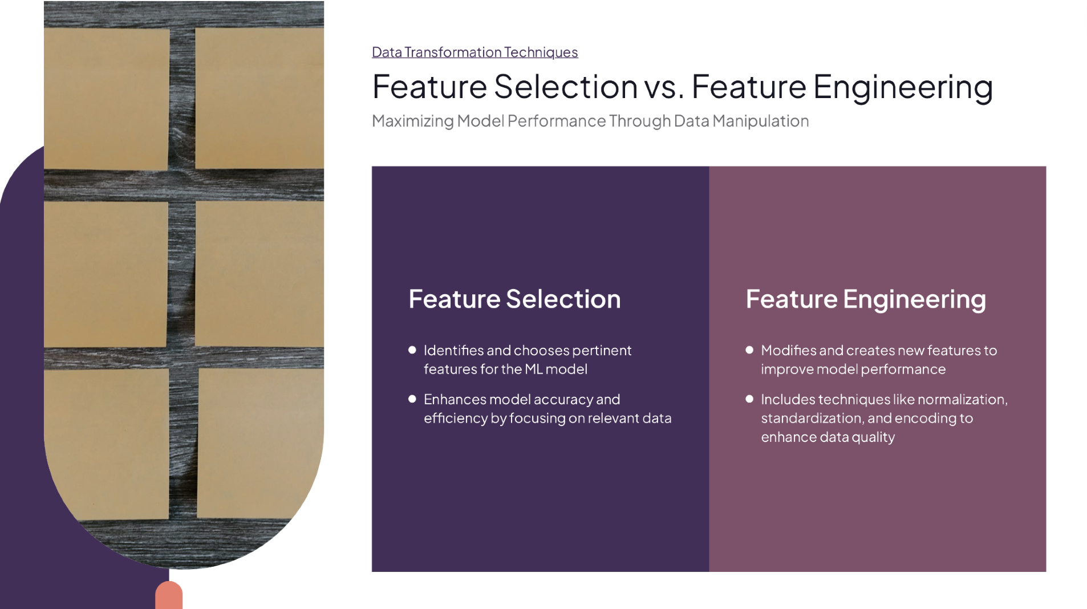

Slide 26
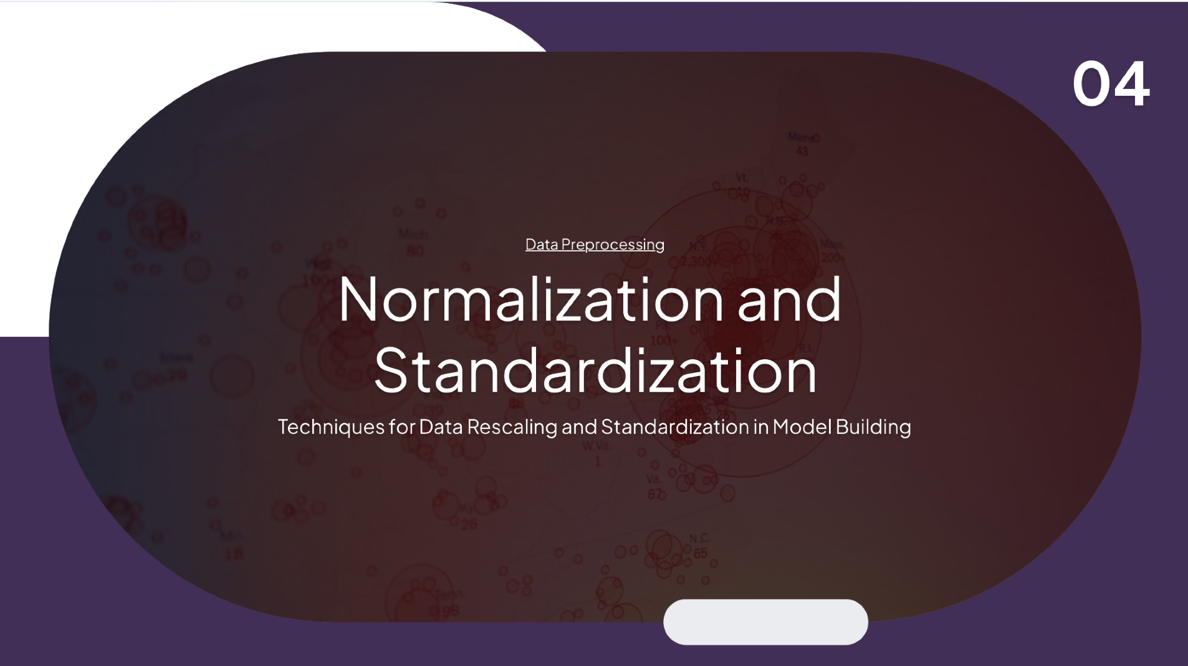

Slide 27


Slide 28
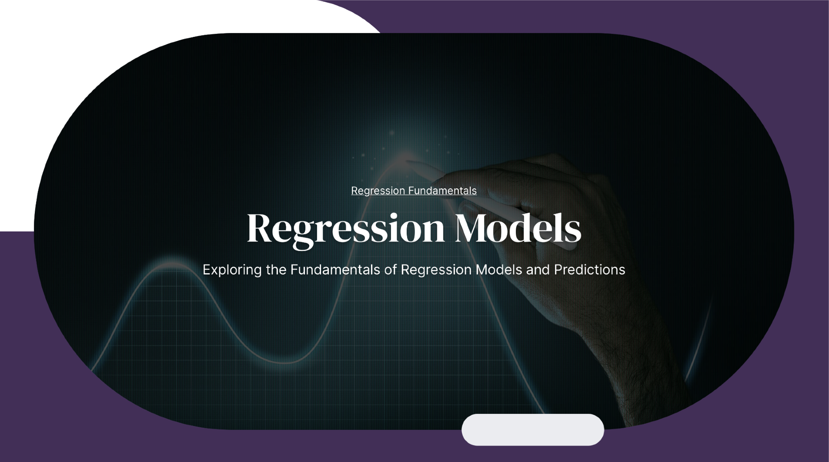

Slide 29
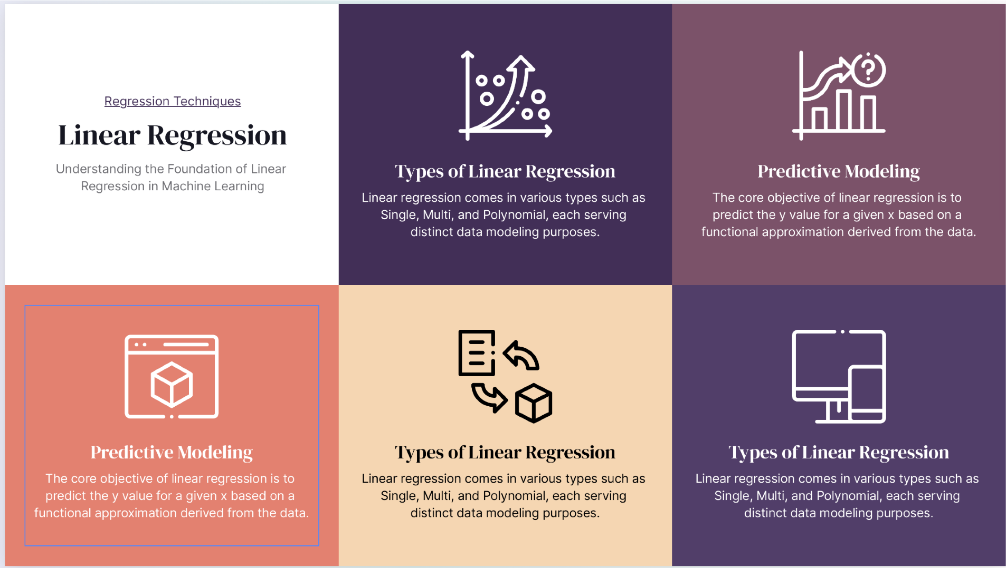

Slide 30
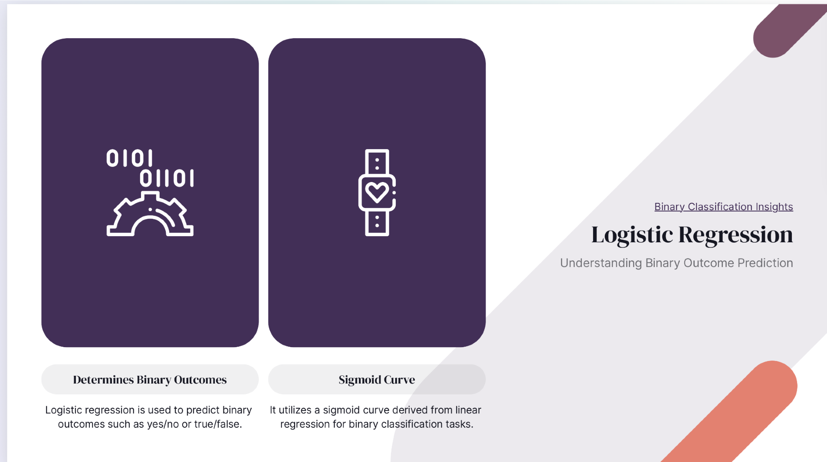

Slide 31


Slide 32
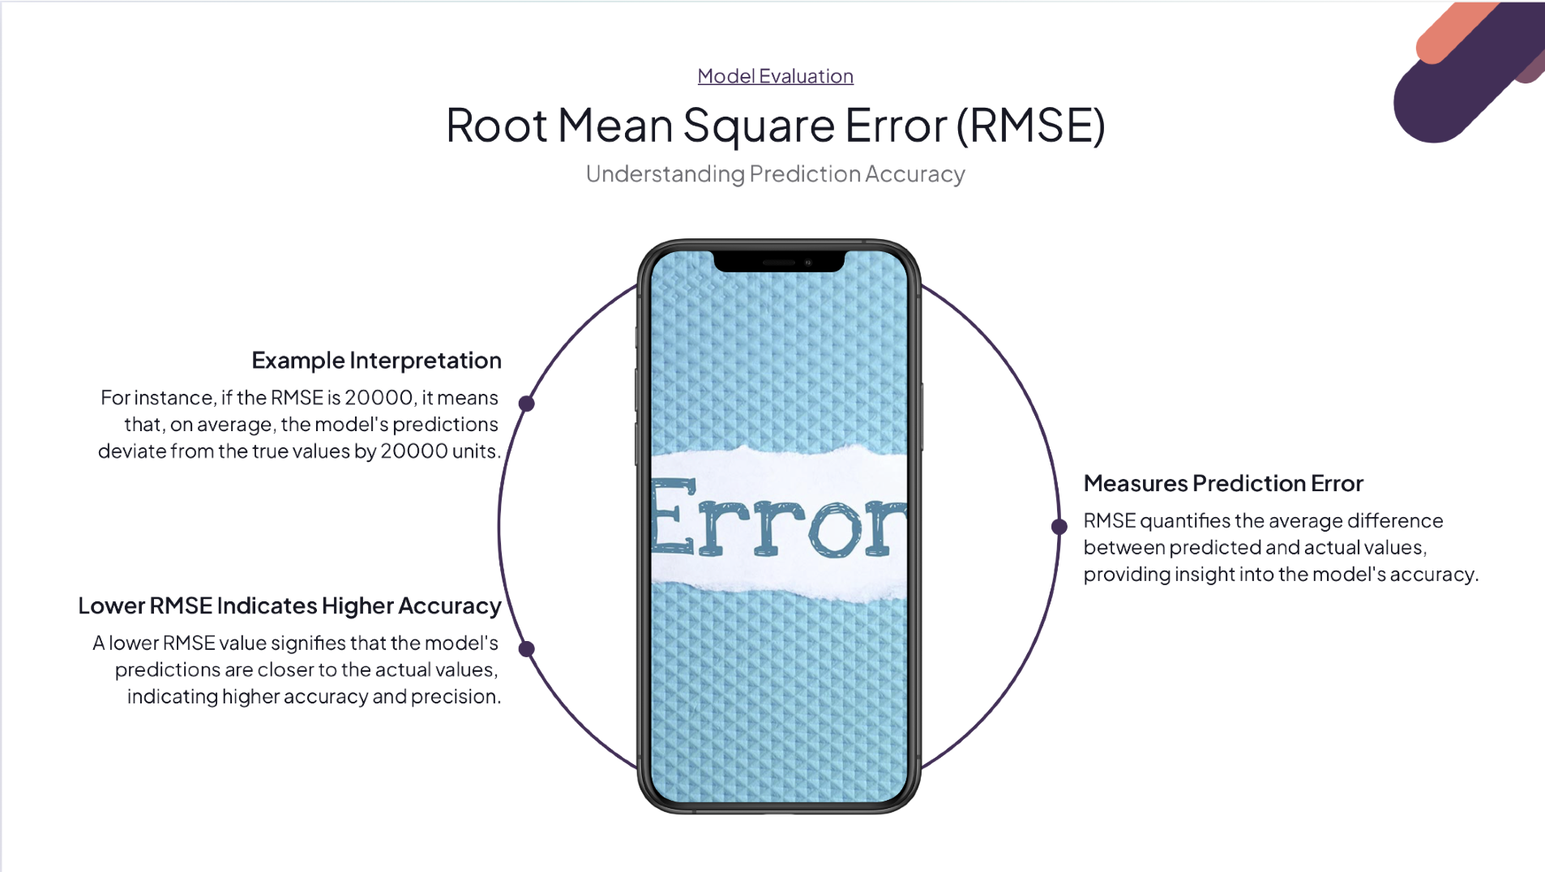

Slide 33


OBSERVATIONS
Also worked on codes which perform data loading, preprocessing, visualization, and machine learning tasks. It reads datasets (`Mall_Customers.csv` and `USA_Housing.csv`), creates box plots for various features, handles missing values, and scales data using standardization. Visualization is performed using matplotlib and seaborn. Machine learning models, including RandomForest, XGBoost, LightGBM for regression, and KMeans, DBSCAN, Agglomerative Clustering for clustering, are trained and evaluated. It also includes linear, polynomial, and decision tree regression models, with model performance evaluated using Mean Squared Error. Additionally, the code demonstrates handling outliers, normalizing data, and filling missing values using different strategies.

Slide 34
CONCLUSION
In this analysis, I have conducted EDA, data preprocessing, and data cleaning. Regression algorithms such as RandomForest, XGBoost, LightGBM, Linear, Polynomial, and Decision Tree were applied. Outliers were treated, and feature engineering and selection were performed. Models were evaluated using Mean Squared Error to ensure robust predictions.

